Slide 1
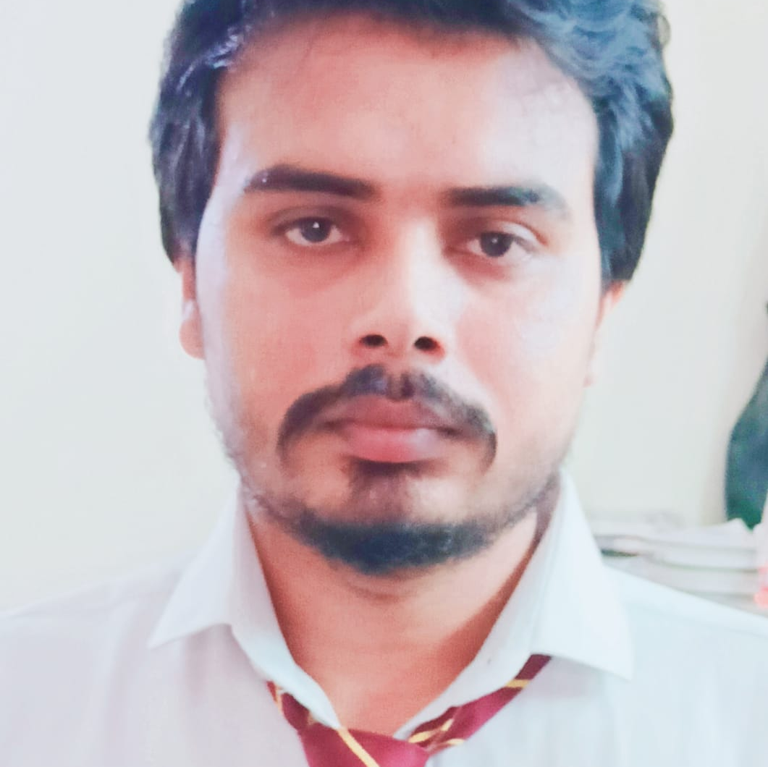

ASHVANI KUMAR
Analyst/Software Engineer
Bachelor of Technology,
Computer Science & IT : 2018-22
I Transform L&D Left shift batch
Skills
BANGALORE
C# | Basics, OOPS, Exception Handling ,Arrays.
.NET Framework | ADO.NET,ASP.NET with MVC and WEB API, Entity Framework
C/C++ | Basics, OOPS, Exception Handling ,Arrays
Database | SQL
Tools | GIT,POSTMAN
UI Technology | HTML5 ,CSS & Angular
Add On Skills | Communication Skills, Team Management
ashvani.kumar@capgemini.com
+91 9759886406
A4
Full Stack Developer
Understanding of RDBMS concepts using SQL Server.
Practical understanding of C# and SQL concepts using Visual Studio and SQL Server
Hands on experience in developing applications using .NET Framework, ADO.NET Core
Good understanding concepts of Data structure (Linked List ,BST ,stack ,queue)
Understanding of HTML5 , CSS and Angular CLI.
Completed case study on Hotel management. Hotel Management System which is going to be implemented for hotel will automate the major operations of the hotel. The Reservation System is to keep track in room and hall reservation and check availability. The Room Management System is for manage all room types of room services
Technologies used:
ANGULAR
ASP.NET CORE
Microsoft SQL Server
Video Link: click here
github-backend
github-frontend

